Slide 1
Recognising a animal using a Fast AI model
Naveen Chowdary Aliveli

Slide 2
Steps Involved :
Internet enabling check
Installing the Duck Duck Go browser packages
Download images of a animal and non-animal(desert)
Train the model
Testing the model

Slide 3
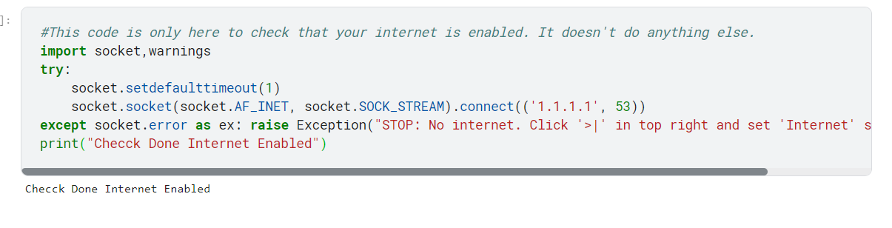
Checking the Internet :

Slide 4
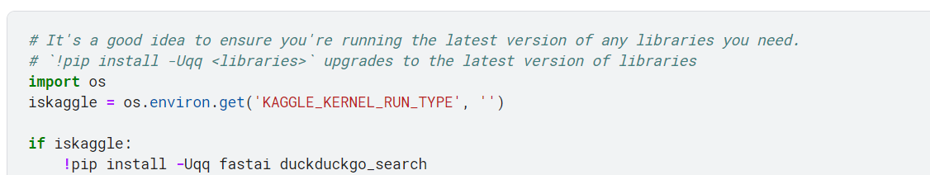
Installing DuckDuckGo module

Slide 5
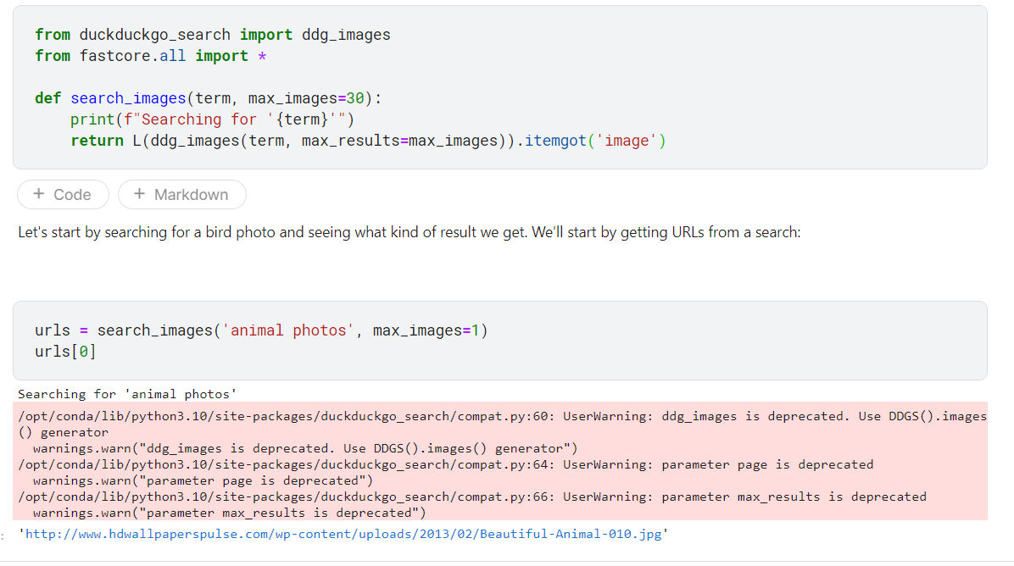
Download images of animal and non-animal

Slide 6
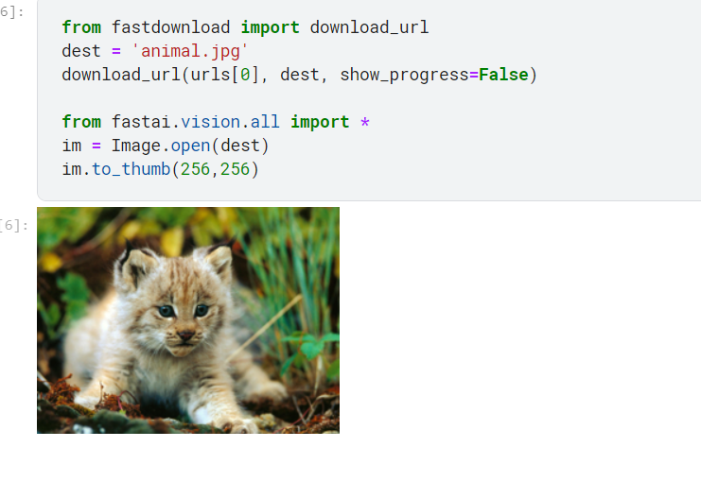
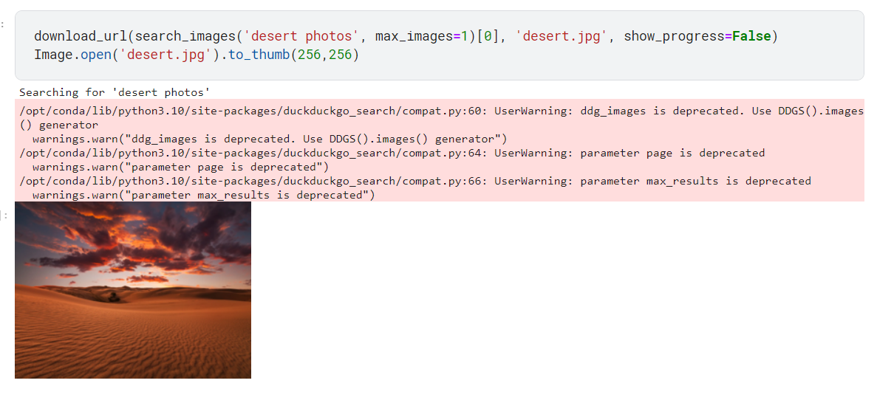
Continue…
Lets see the image of the animal and desert that we downloaded

Slide 7
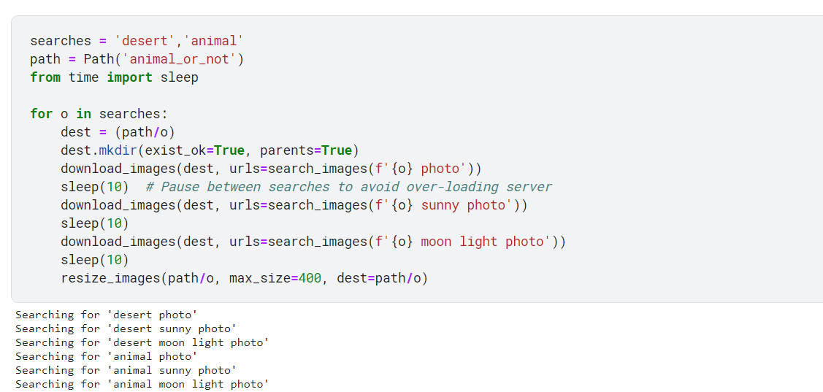
Continue…
Let's grab a few examples of each of "animal" and "desert" photos, and save each group of photos to a different folder

Slide 8
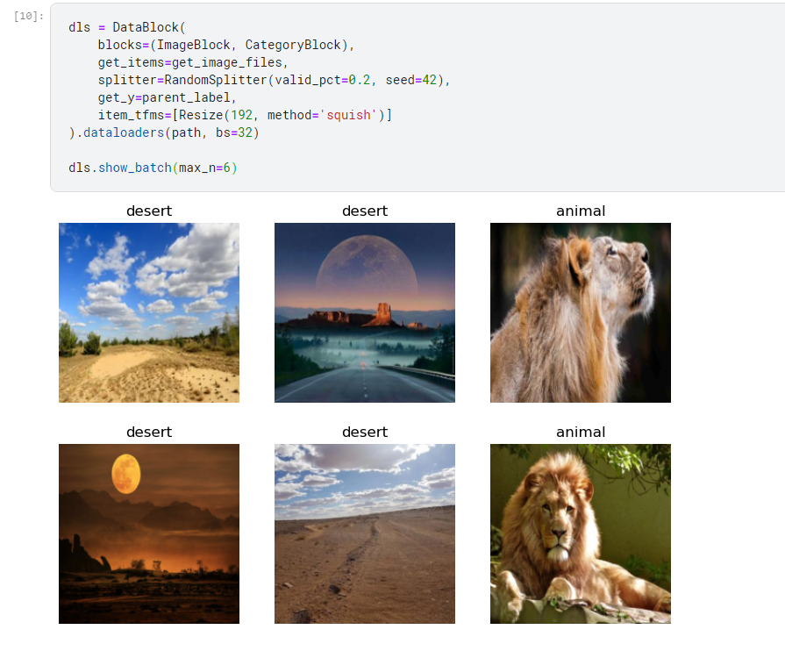
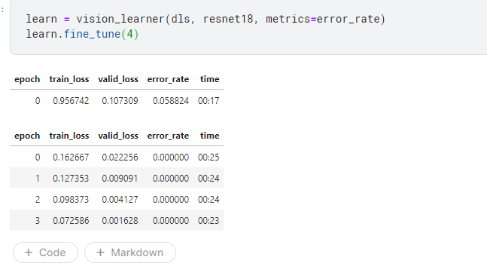
Train the model

Slide 9
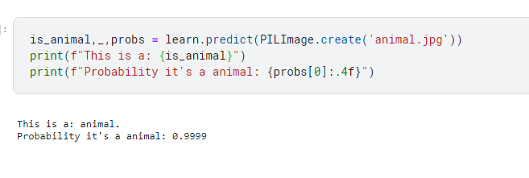
Using the model
Here we are giving the animal image that we downloaded earlier to the model and it was recognizing the given picture as a animal with 99% probability
Link to Kaggle notebook : https://www.kaggle.com/naliveli/is-it-a-animal-model

Slide 10
Thanks!

